Slide 1
LG Boosting
The advantages are as follows:
Faster training speed and accuracy resulting from LightGBM being a histogram- based algorithm that performs bucketing of values (also requires lesser memory)
Also compatible with large and complex datasets but is much faster during training
Support for both parallel learning and GPU learning
Similar to XGBoost, LightGBM is a distributed high-performance framework that uses decision trees for ranking, classification, and regression tasks

Slide 2
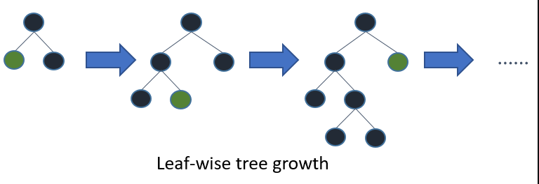
LightGBM carries out leaf-wise (vertical) growth that results in more loss reduction and in turn higher accuracy while being faster. But this may also result in overfitting on the training data which could be handled using the max-depth parameter that specifies where the splitting would occur
It Splits the tree leaf wise.

